Slide 1
ENHANCING HEART DISEASE PREDICTION WITH A HYBRID MACHINE LEARNING APPROACH

Slide 2
GROUP MEMBER INFORMATION
1. Rama Chandra Rohit Mudiam-700747772
2. Snehan Reddy Marri - 700745309
3. Praneeth Reddy Chinnasama- 700741138

Slide 3
ROLE/RESPONSIBILITIES AND CONTRIBUTION IN PROJECT
Rohit- Implementation of Logistic Regression, Naïve Bayes, Support Vector Machine
Snehan-Implementation of K-Nearest Neighbors, Decision Tree, Random Forest
Praneeth-Implementation of XGBoost, Artificial Neural Network and Dataset

Slide 4
MOTIVATION
Heart disease is a prominent cause of death worldwide and poses a significant public health challenge. The World Health Organization (WHO) reports that heart disease is responsible for approximately 17.9 million deaths each year, accounting for approximately 31% of all global deaths (WHO, 2021). The prevalence of heart disease is projected to increase in the future due to factors such as an aging population, urbanization, and changes in lifestyle. Detecting and predicting heart disease at an early stage can substantially reduce the associated morbidity and mortality. Machine learning (ML) techniques have emerged as promising tools for accurately and efficiently predicting heart disease. In this project, we present a novel ML-based approach for effectively predicting heart disease.

Slide 5
OBJECTIVES
Data collection and preprocessing:
Gather a large, diverse and representative dataset of individuals with various demographic, clinical and lifestyle factors.
Feature selection:
Identify the most relevant and significant features for heart disease prediction, such as age, sex, blood pressure, cholesterol levels, smoking habits and family history.
Model selection and evaluation:
1. Choose appropriate machine learning algorithms for the task,
2. Split the dataset into training and test sets to ensure unbiased evaluation of model performance.
3. Evaluate model performance using appropriate metrics like accuracy.
By achieving these objectives, an effective heart disease prediction model can be developed using machine learning techniques.

Slide 6
RELATED WORK
"Heart disease prediction using a hybrid machine learning approach" by Ghosh et al. (2020) - This study proposes a hybrid machine learning approach that combines feature selection techniques with classification algorithms to improve the accuracy of heart disease prediction. The authors compare their approach with several other algorithms and demonstrate its effectiveness.
A machine learning approach for predicting heart disease using demographic and clinical data" by Khera et al. (2019) - In this study, the authors develop a machine learning model to predict heart disease using demographic and clinical data from a large electronic health record database. The model achieves high accuracy and could be useful for identifying high-risk patients.

Slide 7
PROBLEM STATEMENT
Heart disease is one of the leading causes of death globally. Early detection and accurate prediction of heart disease can significantly improve patient outcomes and reduce healthcare costs. Machine learning techniques have the potential to assist in predicting the risk of heart disease by analyzing patient data.

Slide 8
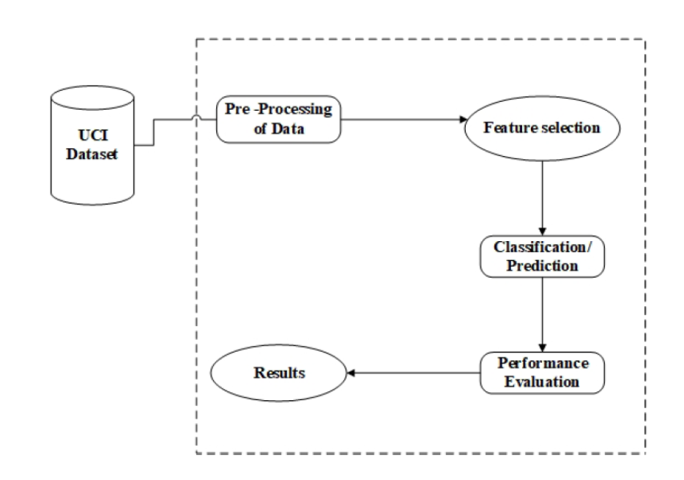
PROPOSED SOLUTION
Logistic Regression
Naïve Bayes
SVM
K-Nearest Neighbor
Decision Tree
Random Forest
XGBoost

Slide 9
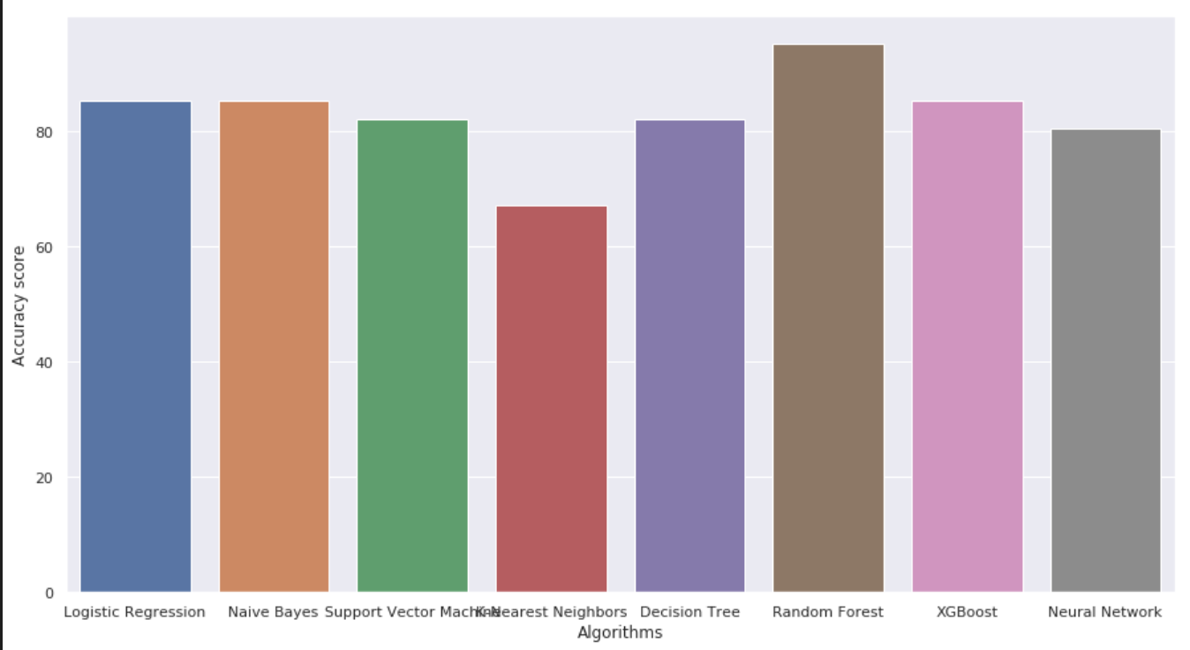
RESULTS

Slide 10
CONCLUSION
Upon conducting a thorough comparison of various machine learning algorithms, the random forest algorithm demonstrated superior performance with an accuracy of 95.08%. In contrast, logistic regression achieved an accuracy of 85.25%, Naive Bayes and XGBoost both attained an accuracy of 85.25%, SVM achieved 81.97%, Decision Tree attained 81.97%, Neural Network achieved 80.33%, and K-NN obtained 67.21%. These results highlight the effectiveness of the random forest algorithm in achieving higher accuracy compared to other algorithms in the context of heart disease prediction.

Slide 11
REFERENCES
[1] Rehman, S., Rehman, E., Ikram, M. et al. cardiovascular disease (CVD): assessment, prediction, and policy implications. BMC Public Health 21, 1299 (2021). https://doi.org/10.1186/s12889-021-11334-2.
[2] Apurv Garg, Bhartendu Sharma and Rijwan Khan, Heart disease prediction using machine learning techniques, Apurv Garg et al 2021 IOP Conf. Ser.: Mater. Sci. Eng. 1022 012046, DOI 10.1088/1757-899X/1022/1/012046.
[3] S. Mohan, C. Thirumalai, and G. Srivastava, "Effective Heart Disease Prediction Using Hybrid Machine Learning Techniques," in IEEE Access, vol. 7, pp. 81542- 81554, 2019, doi: 10.1109/ACCESS.2019.2923707.
[4] M. Kavitha, G. Gnaneswar, R. Dinesh, Y. R. Sai, and R. S. Suraj, "Heart Disease Prediction using Hybrid machine Learning Model," 2021 6th International Conference on Inventive Computation Technologies (ICICT), Coimbatore, India,2021, pp.1329-1333, doi: 10.1109/ICICT50816.2021.9358597.
[5] S. Kalta and R. Bhatt, "A Comparison Analysis of Heart Disease Dataset Using Decision Tree and Back-Propagation Network," 2021 Sixth International Conference on Image Information Processing (ICIIP), Shimla, India, 2021, pp. 556-561, doi: 10.1109/ICIIP53038.2021.9702667.

